Slide 1


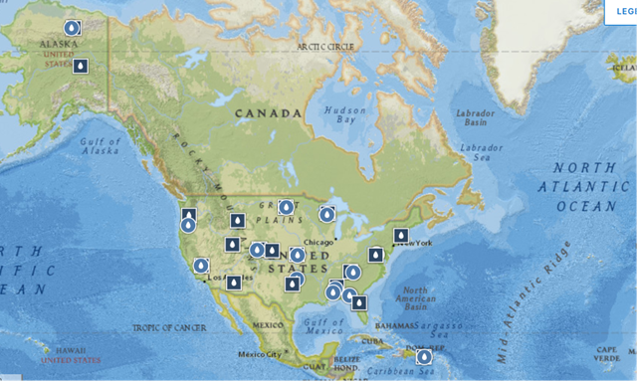
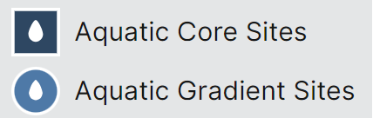
Microbial cell density and its environmental controls in 34 aquatic ecosystems across the U.S.
B33J-2368
Nathan Zhao¹, Xiaofeng Xu²
1. Parkway Central High School, Chesterfield, MO, USA; 2. Biology Department, San Diego State University, San Diego, CA, USA; (xxu@sdsu.edu)
Parkway Central High School
Rational
Site
Coordinates
State
Type
Site
Coordinates
State
Type
Figure 3. Relative variation of microbial cell count at monthly scale for all sites.
There is clear seasonality in microbial cell count in aquatic ecosystems across the 34 NEON sites across the U.S.
Large variation in microbial seasonality among sites.
The lowest microbial cell count was in January, February, and March. Recovery in microbial cell count from April, May, to June; highest in July, August, September, and October; decreases in November and December.
A strong association between monthly temperature and monthly microbial cell count suggests a strong temperature impact at the seasonal scale, which differs from the temperature impact across space.
Average 50% to 200% of microbial cell count in different months, relative to the annual mean (mean across all sites).
Microbes are the ultimate drivers of the biogeochemical cycling of nutrients. Aquatic microbes are different from those in terrestrial systems mainly due to dispersal across habitats. The cell count of microbes in the water body may partially reflect the magnitude of microbial processes on carbon mineralization, nitrification, denitrification, etc. Meanwhile, microbial cell density can indicate the quality of the water body it inhabits. Therefore, understanding the microbial cell count in water bodies and its major controls at a regional scale can provide important information for understanding ecosystem health and functions. By examining the cell count and sampled water volume across the 34 aquatic core sites within the National Ecological Observatory Network (NEON), we examined the microbial cell density and its association with water temperature, conductance, and dissolved oxygen. The biogeographic pattern of microbial cell counts in water bodies and their environmental controls are vital information for better understanding microbial roles in carbon and nutrient cycling in aquatic ecosystems across the space under the changing climate.
HOPB
42.47194
-72.32953
Massachusetts
Core
PRPO
47.12984
-99.25315
North Dakota
Core
POSE
38.89431
-78.14726
Virginia
Core
PRLA
47.15909
-99.11388
North Dakota
Gradient
LEWI
39.09564
-77.98322
Virginia
Gradient
ARIK
39.75821
-102.44715
Colorado
Core
BARC
29.67598
-82.00841
Florida
Core
PRIN
33.37852
-97.78231
Texas
Core
SUGG
29.68778
-82.01775
Florida
Core
BLUE
34.44422
-96.62420
Oklahoma
Gradient
FLNT
31.18542
-84.43740
Georgia
Gradient
BLDE
44.95011
-110.58715
Wyoming
Core
CUPE
18.11352
-66.98676
Puerto Rico
Core
COMO
40.03496
-105.54416
Colorado
Core
GUIL
18.17406
-66.79868
Puerto Rico
Gradient
WLOU
39.89137
-105.91540
Colorado
Gradient
(a)
(b)
Methodology – Site information
CRAM
46.20967
-89.47369
Wisconsin
Core
SYCA
33.75099
-111.50809
Arizona
Core
LIRO
45.99827
-89.70477
Wisconsin
Gradient
REDB
40.78393
-111.79789
Utah
Core
KING
39.10506
-96.60383
Kansas
Core
MART
45.79084
-121.93379
Washington
Core
MCDI
38.94586
-96.44302
Kansas
Gradient
MCRA
44.25960
-122.16555
Oregon
Gradient
WALK
35.95738
-84.27925
Tennessee
Core
TECR
36.95593
-119.02736
California
Core
LECO
35.69043
-83.50379
Tennessee
Gradient
BIGC
37.05972
-119.25755
California
Gradient
MAYF
32.96037
-87.40769
Alabama
Core
OKSR
68.66975
-149.14302
Alaska
Core
BLWA
32.54153
-87.79815
Alabama
Gradient
TOOK
68.63069
-149.61064
Alaska
Gradient
TOMB
31.85343
-88.15887
Alabama
Gradient
CARI
65.15322
-147.50397
Alaska
Core
Table 1. Description of sampling sites taken from the NEON Domain
(c)
Figure 4. Correlation of microbial cell count with environmental factors, mainly specific conductance (a), dissolved oxygen (b), and water temperature (c). At a monthly scale, specific conductance and water temperature are major controlling factors on microbial cell count in aquatic ecosystems. Dissolved oxygen shows seasonality but is not correlated with microbial cell count, indicating dissolved oxygen has complicated impacts on microbial seasonality.
A negative correlation between dissolved oxygen and microbial cell count was found for a few sites (data now shown).
Figure 1. Location of sampling sites from the NEON Domain
Results
Methodology - Data processing
NEON collect data at 34 aquatic sites, including 24 wadeable streams, 7 lakes, and 3 non-wadeable rivers that are located within 19 of the 20 Domains. The aquatic sites were chosen to be representative of aquatic features and habitats in the US within each NEON Domain. Core aquatic sites are located in areas that are not significantly influenced by built structures, e.g., bridges, or human activities that may impact water quality, such as urbanization, agriculture, or wastewater effluent. Gradient aquatic sites are located in order to capture environmental gradients, such as a hydrologic continuum from headwater stream to large river.
Surface water microbes are collected 12 times per year in wadeable streams and 6 times per year in lakes and non-wadeable streams (rivers) which can be accessed from the online NEON dataset (https://data.neonscience.org/data-products/DP1.20138.001). A Python mini program was coded and used to extracted the data from NEON dataset. Based on the reported cell count and sampled water volume, we calculated the microbial cell density in the water body. Due to the inconsistent data availability across sites, the data of 2021-2022 were used for investigating seasonal variability of microbial density and its controls; the annual average of microbial density was used to investigate biogeographic patterns of microbial density. Once the data was collected, we compiled the data and used a r script to analyze the relationship of microbial cell density with water temperature, dissolved oxygen, and specific conductance. Analysis with the structural equation model approach confirms the interplay of water temperature, dissolved oxygen, and specific conductance and their impacts on microbial density in water bodies.
Take home message
Microbial cell density shows a pattern across space, but the spatial pattern is insignificant for the 34 sites in this study.
Across space, the water temperature and specific conductance are major controlling factors, with specific conductance being stronger than water temperature.
At a monthly scale, specific conductance and water temperature are major controlling factors on microbial cell count in aquatic ecosystems.
A negative correlation between dissolved oxygen and microbial cell count was found for a few sites (data now shown)
A relatively weak seasonal variation indicates microbial tolerance to environmental conditions over a season.
Research is needed to investigate the mechanism for these variations across space and over time.
Figure 2. Correlation matrix of microbial cell density, dissolved O₂, water temperature, specific conductance, and latitude. Microbial cell count is not correlated with water temperature and latitude, indicating that temperature is not the dominant control across space. Specific conductance positively correlated with microbial cell count.
Acknowledgments: This study has been supported by an NSF CAREER project (2145130). We acknowledge the operation of the NEON supported by the NSF.

